Slide 1

SMART PLANT COMMUNICATOR
FACULTY : Prof.Dr. Somasundaram R
SUBJECT : CSE 130 – IoT 1

Slide 2
CONTENTS
AIM
COMPONENTS REQUIRED
DEMO
CIRCUIT DIAGRAM
TINKERCAD LINK
ADVANTAGES AND DISADVANTAGES
CONCLUSION

Slide 3
AIM OF THE PROJECT
The main aim of the project is to communicate with plants.
This project identifies the moisture content from the soil and irrigate the plants frequently.
Thus keeping the plant healthy.

Slide 4
COMPONENTS REQUIRED
1. Arduino uno x 1
2. Jumper wires
3. Red led x 1
4. Orange led x 1
5. Yellow led x 1
6. Green led x 1
7. Blue led x 1
8. Breadboard x 1
9. 220 Ohm resistor x 6
10. 550 Ohm resistor x 1
11. DC motor x 1
12. Soil moisture sensor x 1

Slide 5
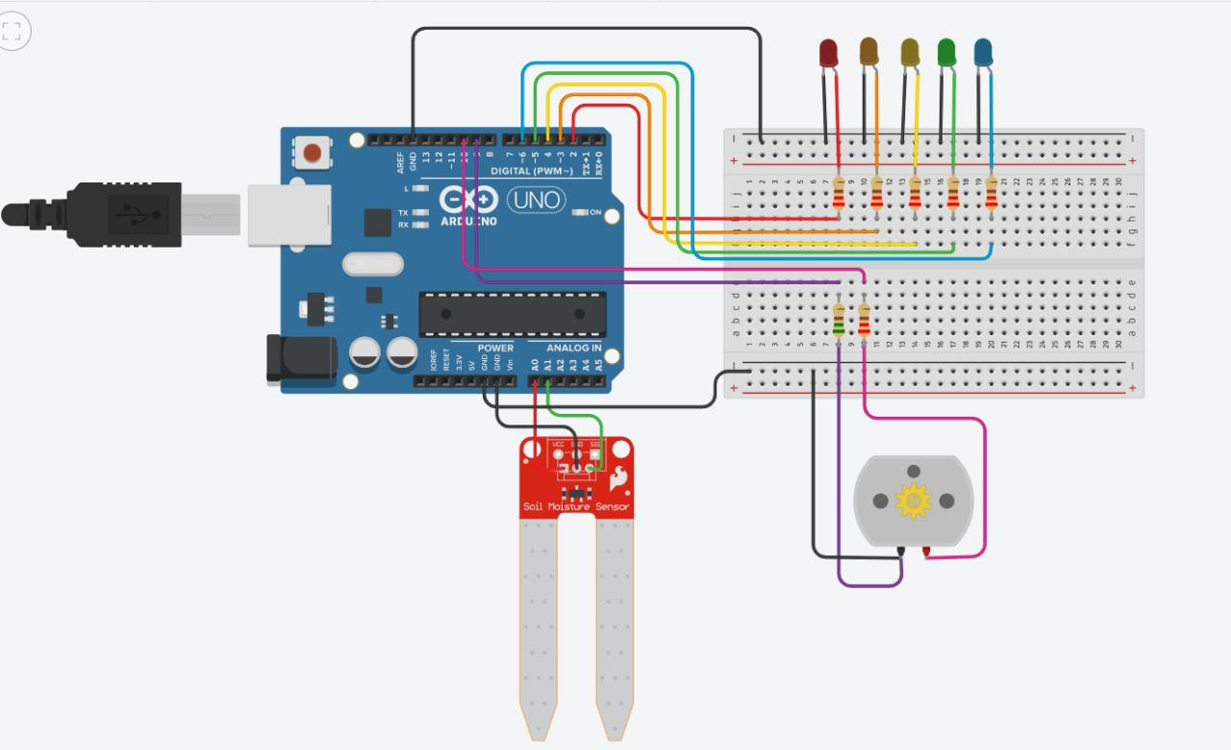
DEMO
c
e
d
e

Slide 6
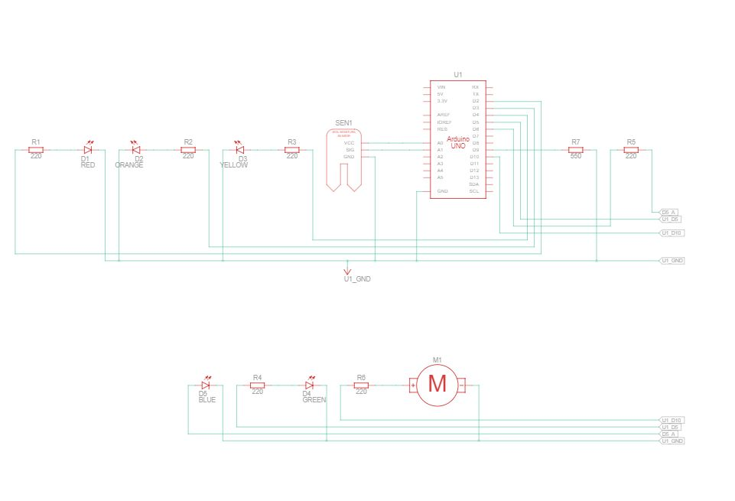
CIRCUIT DIAGRAM
d

Slide 7
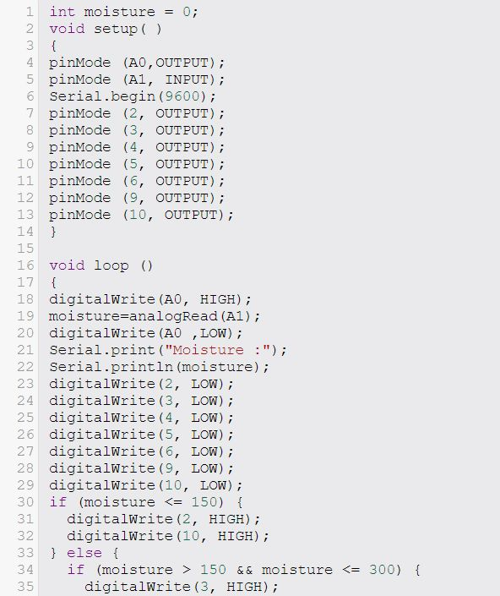
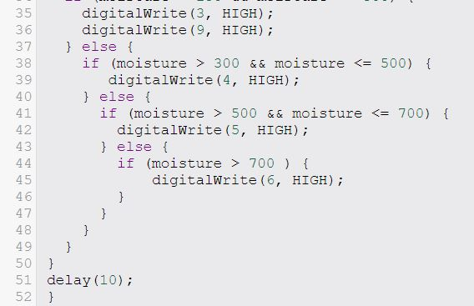
CODE
c
e
d
e

Slide 8
Tinkercad link
https://www.tinkercad.com/things/aa3Fm8HR5sa-smart-plant-communicator/editel?sharecode=G8F3sDygxVh-x-ZfpYDvIbgnn4paqbhGAU-BYp9scks
c
e
d
e

Slide 9
ADVANTAGES & DISADVANTAGES
q
q
q
q
q
s

Slide 10
ADVANTAGES
Reduction of Labour costs.
Timely irrigation — plants being watered when needed.
Management of higher flow rates.
Accurate cut-off of water compared to manual checking.
Reduced runoff of water and nutrients.

Slide 11
DISADVANTAGES
1. Costs for purchasing. installing and maintaining the equipment.
2. Reliability of irrigation system (due to human error when setting up).

Slide 12
CONCLUSION
The soil moisture response monitoring system designed is very simple to
understand and handle.
It can be reprogrammed to add more features. Thus it can be used to check the moisture content for any crop
It is user friendly and can also be used by uneducated farmers.

Slide 13
THANK YOU

